Slide 1
Xilinx IP cores for Digital Signal Processing: modelling and RTL simulation
Aleksei Rostov, PhD,
Senior R&D Engineer,
FPGA/Embedded Linux Developer,
aleksei.rostov@protonmail.com

Slide 2
Course Introduction
Sources are available:
https://github.com/farbius/dsp_xilinx_ip
Xilinx IP cores
DDS Compiler
FIR Compiler
LP, BP, HP FIR
Fast Fourier Transform
Decimation Interpolation
Hilbert Transform
FFT + Windowing
IFFT + Windowing
Modulation schemes
CIC Compiler
Decimation Interpolation
Xilinx IP cores and DSP algorithms
Lectures structure:
Purposes and description of an algorithm (pptx slides)
Math Modelling of an algorithm (Python 3.5)
RTL Simulation of an Xilinx IP core (Verilog, Vivado 2019.1)
aleksei.rostov@protonmail.com

Slide 3
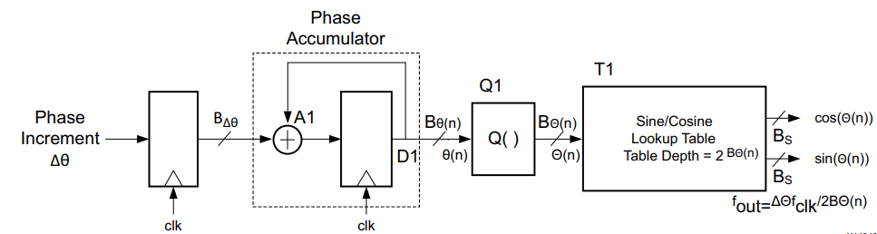
Xilinx IP DDS Compiler (6.0)
RTL Testbench (dds_tb.v)
Task LFM
Task FSK
Task PSK
Task SIN/COS
DDS compiler Applications
up / down converters
demodulation
modulation
Testbench for both configuration: with and without Phase Accumulator
DDS compiler structure
aleksei.rostov@protonmail.com

Slide 4
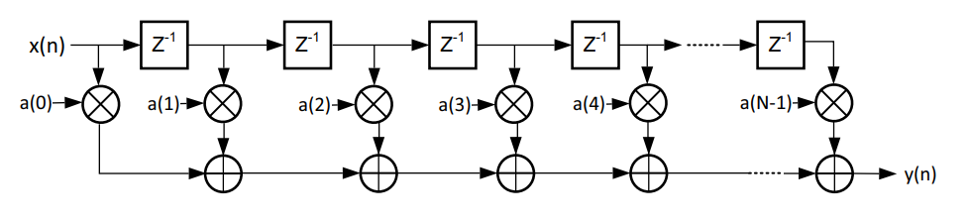
Xilinx IP FIR Compiler (7.2): Low, Pass, High band filters
RTL Testbench (fir_tb.v)
Bandpass
Highpass
Lowpass
FIR compiler application
FIR filters
Decimation / Interpolation
Hilbert Transform
Testbench for FIR filters with loading coefficients via COE files
Convenient FIR filter representation
aleksei.rostov@protonmail.com

Slide 5
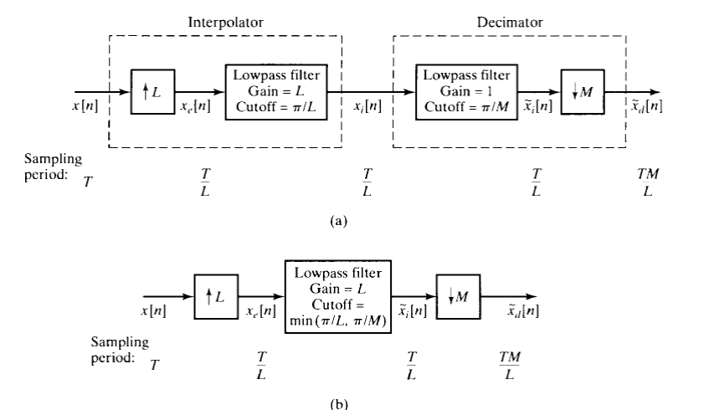
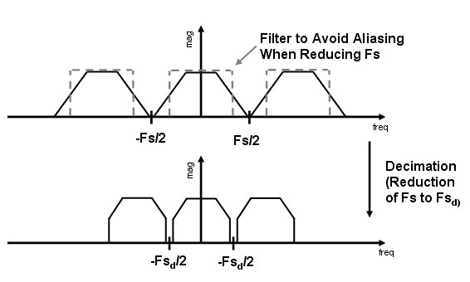
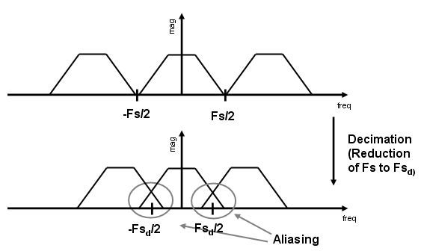
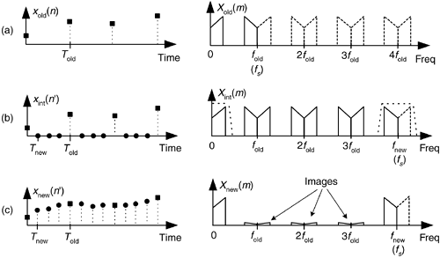
Xilinx IP FIR compiler (7.2), decimation / interpolation
Anti Aliasing Filtering in Decimator
Sample rate conversion by a rational factor:
a) Combination of interpolation and decimation
b) Sample rate converter
RTL Testbench (fir_DecInt_tb.v)
Interpolation
Decimation
Testbench for Decimator and Interpolator with loading coefficients via COE files
a) Low rate signal b) Up sampling c) Interpolation
aleksei.rostov@protonmail.com

Slide 6
Xilinx IP CIC compiler (4.0), decimation / interpolation
RTL Testbench (cic_DecInt_tb.v)
Interpolation
Decimation
Testbench for CIC Decimator and Interpolator
aleksei.rostov@protonmail.com

Slide 7
Xilinx IP FIR compiler (7.2): Hilbert Transform
aleksei.rostov@protonmail.com

Slide 8
FFT IP core: FFT + windowing
aleksei.rostov@protonmail.com

Slide 9
FFT IP core: IFFT + windowing
aleksei.rostov@protonmail.com

